Slide 1
Fill holes by size
A plugin for Fiji
Microscopic Imaging Center

Slide 2
Fill holes by size plugin
Fill background holes in a binary image similar to the 'Fill holes' function, except that you can set the minimum and maximum area size of the holes to fill.
A region of interest can be used to limit the scope of the macro. If no selection has been made (or a non-enclosed one such as a line), the whole image is used.
Note that any background hole found is filled completely, regardless if there are any foreground segments (with potential holes) included within.

Slide 3
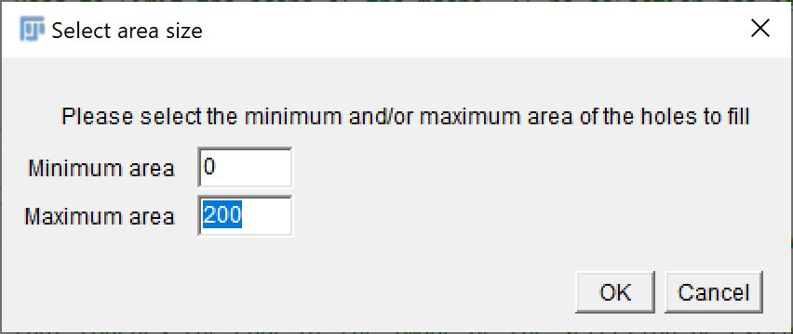
The plugin pipeline
Original binary image with selection (black is background)
Settings dialog
Only holes have of which the size fits been filled

Slide 4
Requirements
Fill holes only works on binary (thresholded) images.
Make sure that the background settings for your binary images are set to the correct colour as background (see Process > Binary > Options > Black background).

Slide 5
User parameters
Minimum size:
Sets the minimum area size for the holes that will be filled. This uses the same unit of measure as the image.
Maximum size:
Sets the maximum area size for the holes that will be filled. This uses the same unit of measure as the image.
Selection:
If a region of interest has been selected, the macro will be limited to the selected area. If no ROI is active, the entire image will be processed.

Slide 6
Adaptation options
Within the ‘Fill holes by size’ macro, several settings can be configured:
Minimum size: Sets the minimum size for the holes that will be filled. When configured, the user will not have the option to change it when running the macro. Use -1 to have the user choose for every run of the plugin.
Maximum size: Sets the maximum size for the holes that will be filled. When configured, the user will not have the option to change it when running the macro. Use -1 to have the user choose for every run of the plugin.
Exclude edges: Should any background area that touches the edge of the image or the selection be excluded from being filled or not? When set to ‘true’, any area that touches the side of the image is automatically not considered a hole.

Slide 7
Installation
Copy the plugin to the ‘plugins/Macros’ folder in your Fiji.app installation folder.

Slide 8
User manual
In order to use the macro, make sure that a binary image is the currently active image. A binary image is any 8-bit image with only the pixel values 0 and 255.
Start the plugin via Plugins > Macros > Fill holes size. Note that any installed macros can be found at the very bottom of the plugin menu and you may have to scroll there.
If a standard value for the minimum and/or maximum size has not been configured, there now will be a dialog in which the user can set these. Fill in the required values and press OK.
For the minimum, an area of ‘0’ will be result in no holes being disqualified due to a minimum area.
Similarly, the total area of the image (i.e. width times height) will result in no maximum cut-off.

